Slide 1
Pathtrak 4.1 Quick Tip #2
October 27,2014
Notes:
Welcome to this quick overview of PathTrak 4.0.

Slide 2
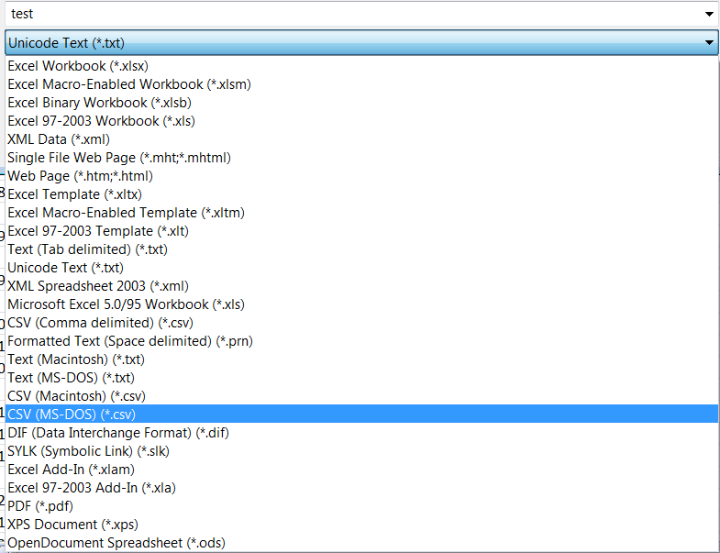
Monitoring plan Error on Import
There is an error in how XL saves the CSV file.
The work around is to save monitoring plan as CSV (MS-DOS (*csv)
Then import Plan

