Slide 1
Napatech filters
Jan 21 2019

Slide 2
Configuration files
On agent config files – CP:
Directory
/xsight/etc/opt/napatech/config
Config files
ntpl.cfg
  Setting filters
ntservice.ini
  Adding host buffers

Slide 3
Filters
ntpl.cfg
# set up the stream
setup[NUMANode=1;minHostBufferSize=16]=StreamId==98
# define the filters
DefineMacro("mIPv4VersionLength", "Data[DynOffset=DynOffIPv4Frame;Offset=0;DataType=ByteStr1]")
DefineMacro("mIPv4TotalLength", "Data[DynOffset=DynOffIPv4Frame;Offset=2;DataType=ByteStr2]")
DefineMacro("mIPv4NextProto", "Data[DynOffset=DynOffIPv4Frame;Offset=9;DataType=ByteStr1]")
DefineMacro("mSCTPChunkType", "Data[DynOffset=DynOffIPv4Frame;Offset=32;DataType=ByteStr1]")
#assign the stream filter
Assign[streamid=98;priority=15] = mIPv4VersionLength==0x45 and mIPv4TotalLength==0x0030 and mIPv4NextProto==0x84 and mSCTPChunkType==0x03
ntservice.ini
HostBuffersRx = [1,1024,1],[2,16,1],[2,16,1]

Slide 4
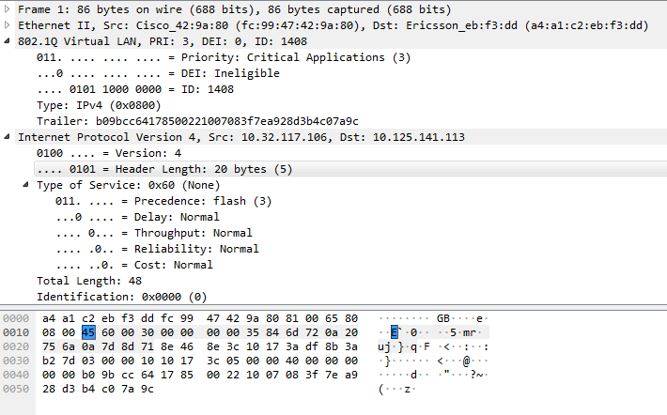
Breaking filters down
# define the filters
DefineMacro("mIPv4VersionLength", "Data[DynOffset=DynOffIPv4Frame;Offset=0;DataType=ByteStr1]")
#assign the stream filter
Assign[streamid=98;priority=15] = mIPv4VersionLength==0x45 and mIPv4TotalLength==0x0030 and mIPv4NextProto==0x84 and mSCTPChunkType==0x03
Offset 0, byte 1

Slide 5
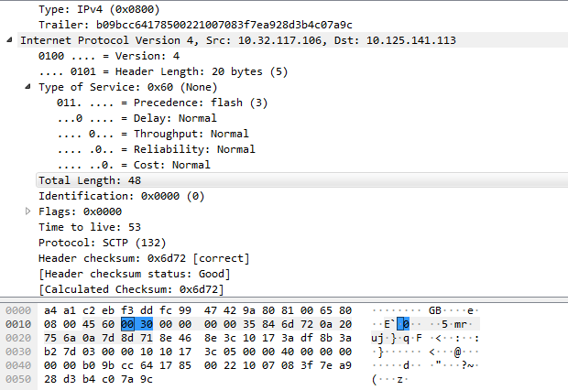
Breaking filters down
# define the filters
DefineMacro("mIPv4TotalLength", "Data[DynOffset=DynOffIPv4Frame;Offset=2;DataType=ByteStr2]")
#assign the stream filter
Assign[streamid=98;priority=15] = mIPv4VersionLength==0x45 and mIPv4TotalLength==0x0030 and mIPv4NextProto==0x84 and mSCTPChunkType==0x03
Offset 2, bytes 2

Slide 6
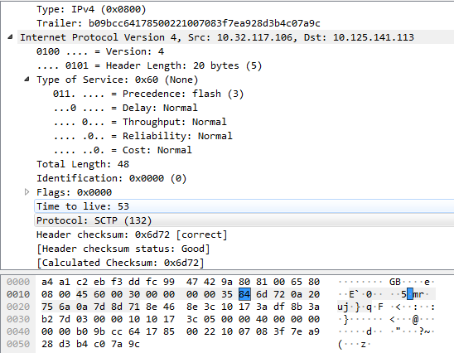
Breaking filters down
# define the filters
DefineMacro("mIPv4NextProto", "Data[DynOffset=DynOffIPv4Frame;Offset=9;DataType=ByteStr1]")
#assign the stream filter
Assign[streamid=98;priority=15] = mIPv4VersionLength==0x45 and mIPv4TotalLength==0x0030 and mIPv4NextProto==0x84 and mSCTPChunkType==0x03
Offset 9, bytes 1

Slide 7
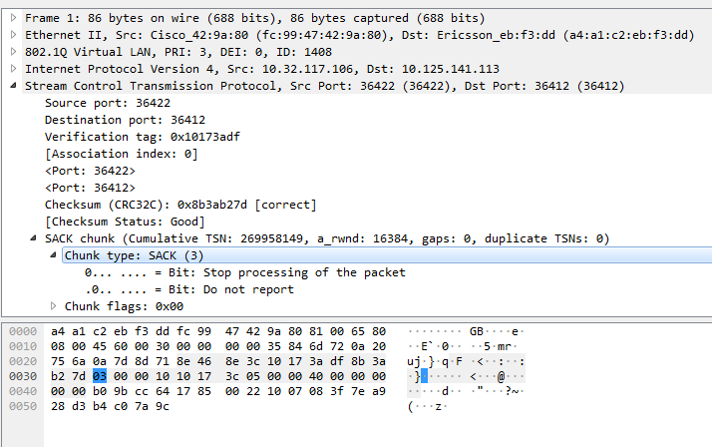
Breaking filters down
# define the filters
DefineMacro("mSCTPChunkType", "Data[DynOffset=DynOffIPv4Frame;Offset=32;DataType=ByteStr1]")
#assign the stream filter
Assign[streamid=98;priority=15] = mIPv4VersionLength==0x45 and mIPv4TotalLength==0x0030 and mIPv4NextProto==0x84 and mSCTPChunkType==0x03
Offset 32, byte 1

Slide 8
Stopping/Starting Napatech
When creating filters, it is always best to restart napatech with following command.
This will provide more details if your filter is not loading.
/etc/init.d/napatech start
/etc/init.d/napatech stop

