Slide 1
Job Definitions
An Overview of Features

Slide 2
Job Definition Constituents
Name
Test Map
  2 dimensional grid of fiber tests
  Optional column and row labels
Test and Report Order
  Left to Right:
    “Next Fiber” moves one grid cell to the right.
    Final report lists tests in order of left to right, row by row.
  Top to Bottom:
    “Next Fiber” moves one grid cell down.
    Final report lists test in order top to bottom, column by column.

Slide 3
Job Definition Activities
Design-time Activities
  Managing job definitions: Create, edit, delete, import etc.
Run-time Activities
  Start Job
  Run tests
  Save report and close Job

Slide 4
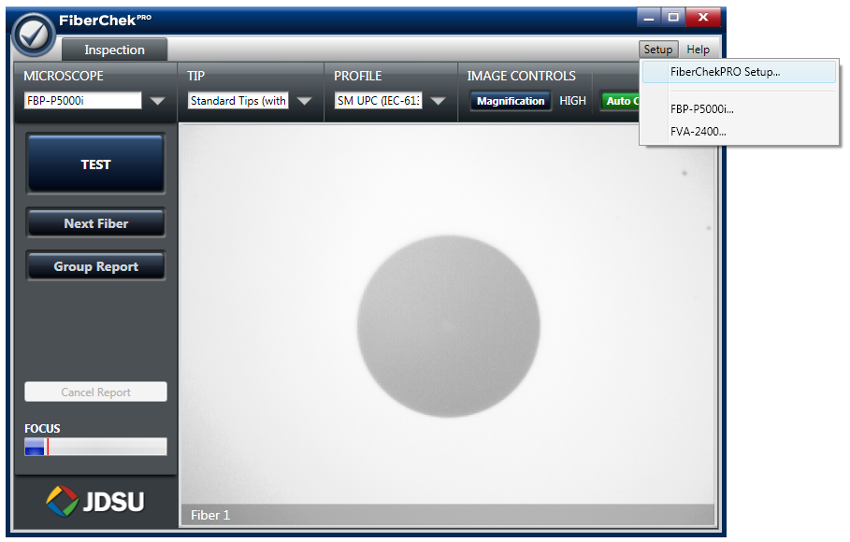
Design Time: Managing Job Definitions

Slide 5
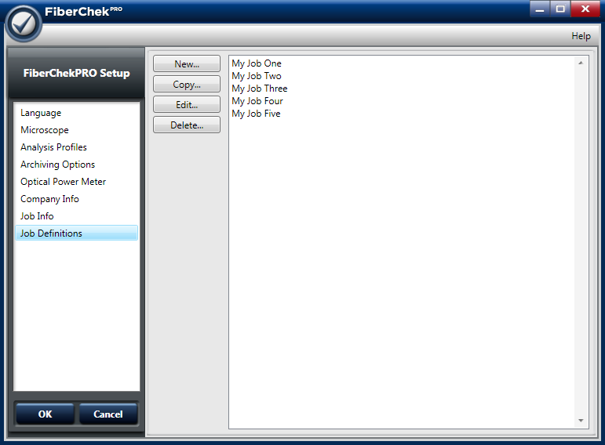
Managing Job Definitions

Slide 6
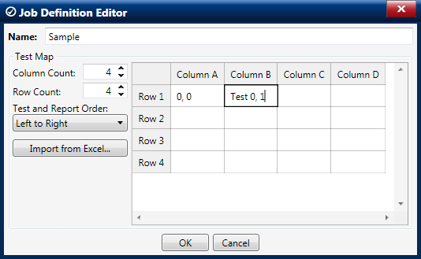
Job Definition Editor

Slide 7
Creating a Test Map
Any or all of the column and row labels may be empty.
All non-empty grid cells become fiber tests with the corresponding test name.
Empty grid cells are treated as “spacers” and do not become fiber tests.
Duplicate test name are allowed.
Edit mechanisms:
  Manual Entry
  Import from Excel

Slide 8
A. Manual Entry
Type into cells for columns & row headings and for test names.
add & remove columns & rows

Slide 9
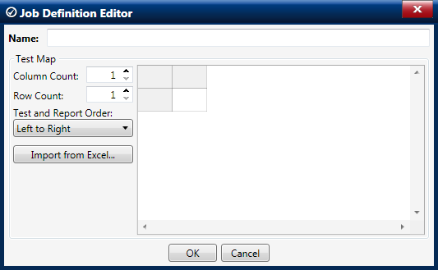
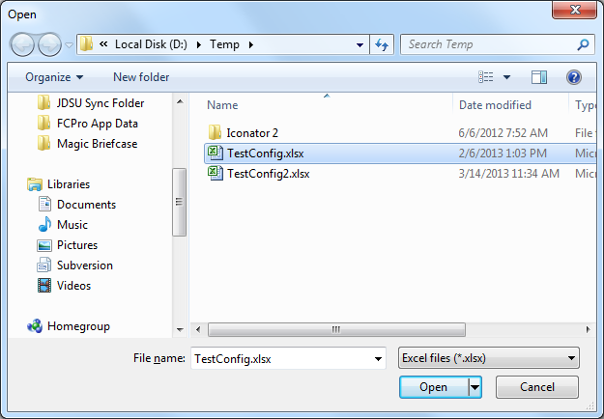
B. Import from Excel
1.
2.

Slide 10
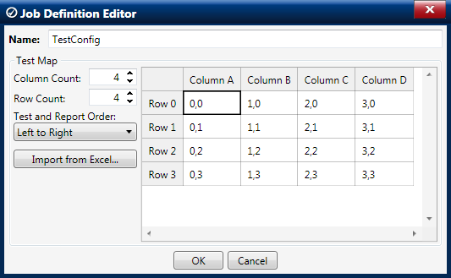
B. Import from Excel (cont.)
Number of columns and rows automatically adjusted and cells populated.
3.

Slide 11
Excel Import Guidelines
The upper-left corner of the grid (including column and row labels) must be cell “A1” on the first worksheet of the Excel document.
If including column and row labels, leave cell “A1” empty. The remaining cells of row “1” become the column labels, and the remaining cells of column “A” become the row labels.
If cell “A1” is not empty, the Test Map will not have column or row labels and all the cells will become test names.
Only the first worksheet is imported; all others are ignored.
Cell formatting (font, color, etc.) is not imported.

Slide 12
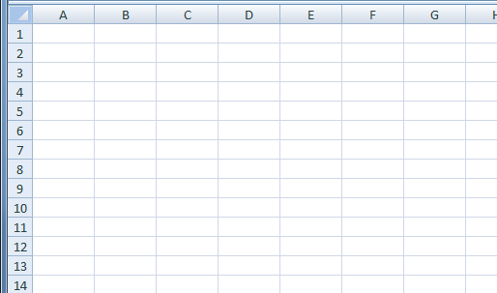
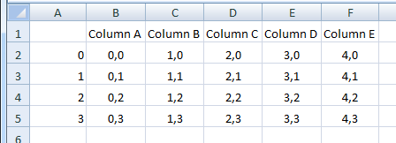
Excel Import Guidelines (cont.)
With Column and Row Labels
Blank cell
Column Labels
Test Names
Row Labels

Slide 13
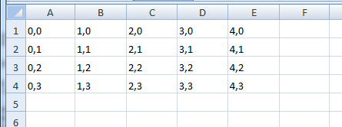
Excel Import Guidelines (cont.)
Without Column and Row Labels
Test Names

Slide 14
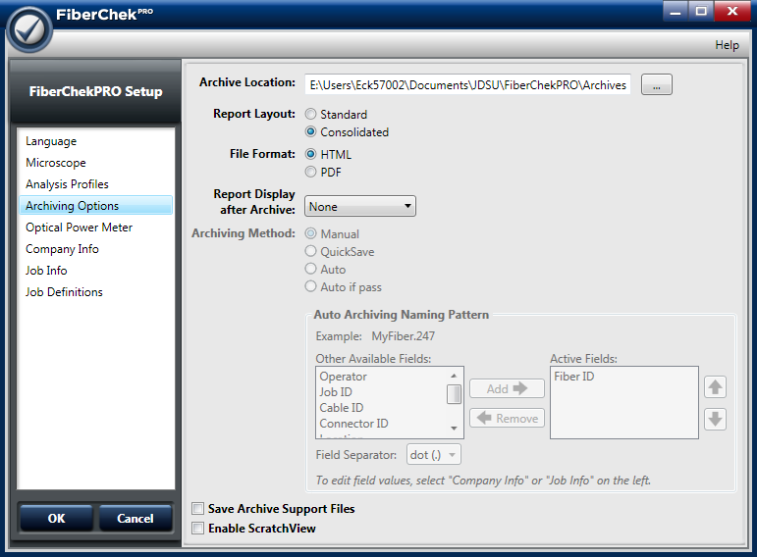
Run Time: Starting a Job
Ensure that your Report Layout is set to “Consolidated”

Slide 15
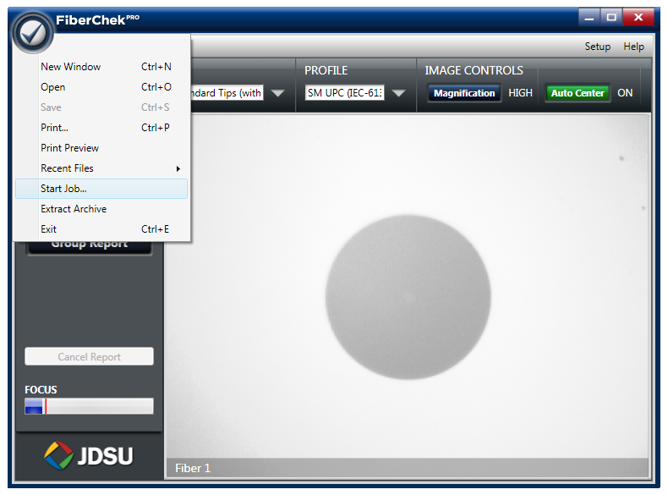
Run Time: Starting a Job

Slide 16
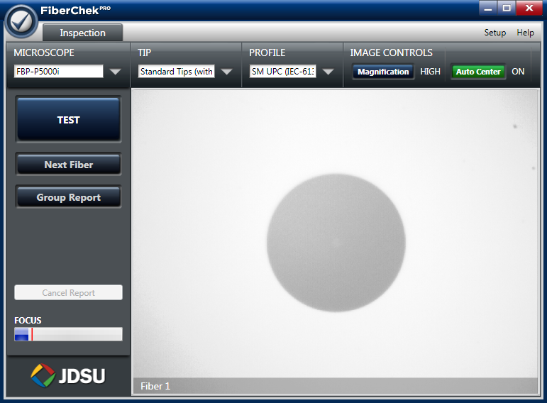
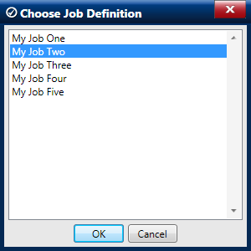
Starting a Job (cont.)

Slide 17
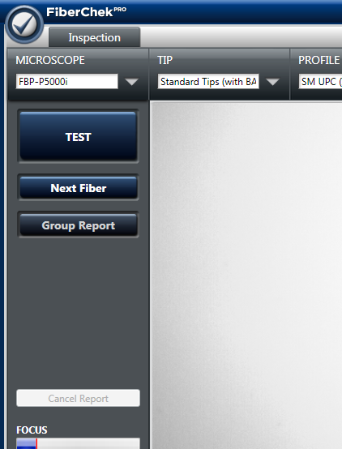
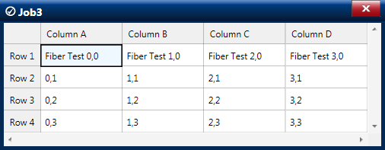
Starting a Job (cont.)
Ready to Roll!

Slide 18
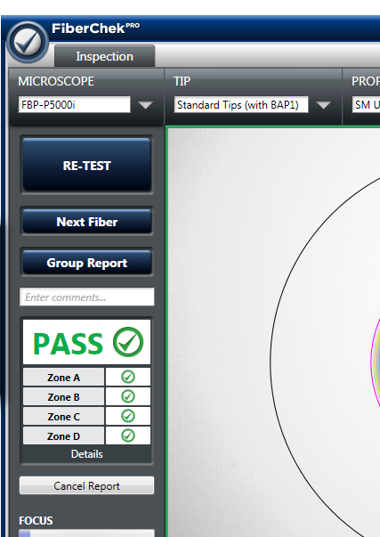
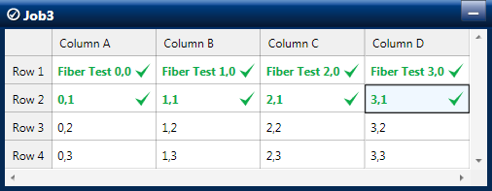
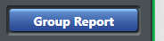
Finishing a Job

Slide 19
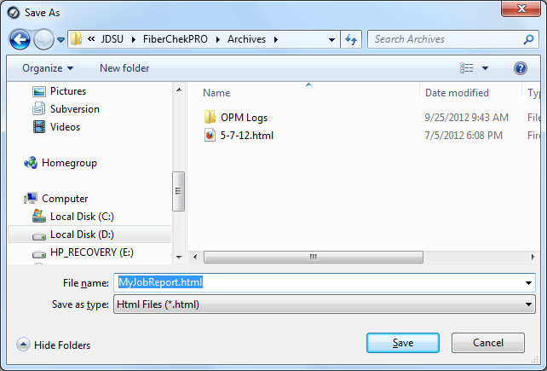
Finishing a Job

Slide 20
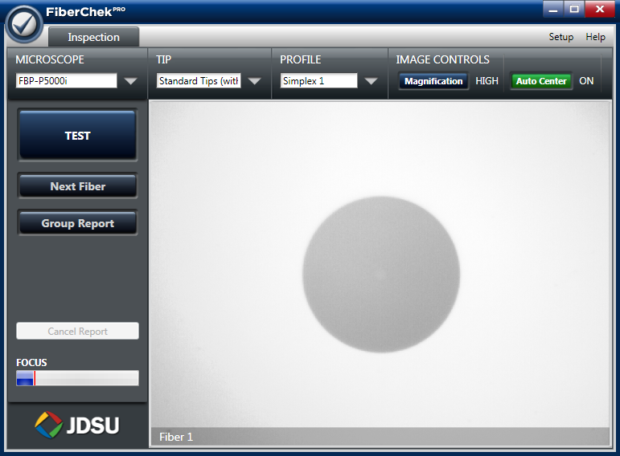
Back to the Starting Point

