Slide 1
DSAM WiFi Mode
Last Edited: July 2013

Slide 2
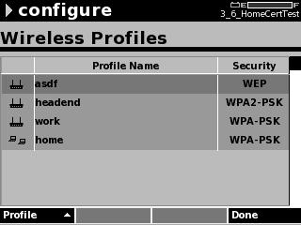
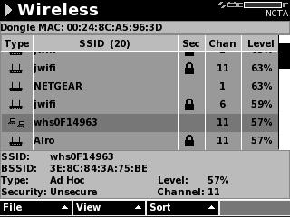
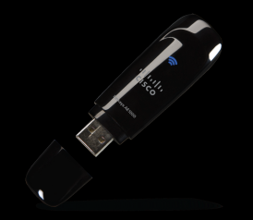
WiFi – Troubleshooting and Connectivity
DSAM WiFi
802.11a/b/g/n USB Connection
Profiles for frequent hotspots
Dual 2.4GHz and 5GHz Bands
Useful Applications
Troubleshooting Slow Surfing
Verify Web connectivity via WiFi
Synch configurations and test results between DSAM and TPP
Validating Router Configurations
Results can be Saved/Archived
WiFi Troubleshooting:
SSID
Security Enabled or not
Channel of WiFi signal
Power Level of Signal

Slide 3
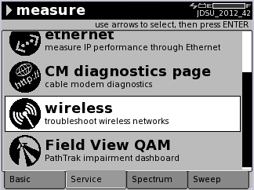
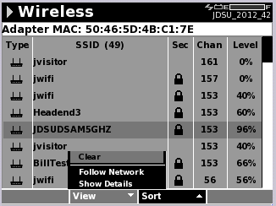
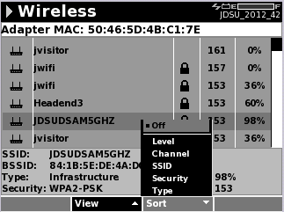
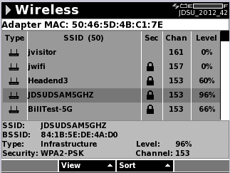
Site Survey Mode
To begin Wireless Site Survey Mode
  Measure button
  Service tab
  Wireless mode
Once in the mode the list of available WiFi networks is presented
View Menu allows:
  Following specific networks
  Additional network details
Sort Menu sort the data by:
  Level, Channel, SSID, Security, and network type
Continuous updates allow techs to move around
Notes:
Channels below 14 are in the 2.4GHz range while those above channel 14 are in the 5GHz range.

Slide 4
Wireless Site Survey Screen
DSAM’s WiFi Adapter MAC
List of WiFi networks detected
Highlighted Network’s Information
Scroll bar indicated that more networks than can be displayed are available for viewing

Slide 5
WiFi Uses - Subscriber Issue:
Can’t maintain good connection to wireless access point (AP) or Slow surfing speed
  Tech checks the following on the subscribers network
    If Signal strength at location of interest is low – Move the AP
      Avoid large distances or obstructions that can weaken the WiFi signal
        Brick/Concrete/Metal Walls, appliances, or furniture can absorb or deflect WiFi signals
      WiFi signals typically transmit at the same level in all directions so placing the AP in a more central location allows for the most coverage
    Identify a less occupied channel and move the AP to that channel
      If many networks use the same WiFi Channel they will conflict and cause slower surfing speeds on all networks on the same channel
      Try to use non-overlapping channels to prevent the most conflicts
        In the 2.4GHz band only channels 1, 6, and 11 do not overlap
        In the 5GHz band all channels are non-overlapping
    Secure the WiFi network with Password protection
      Unsecure, or Open, networks leave the subscriber open for anyone to use the WiFi network which could mean unauthorized users are using too much of the network’s available bandwidth – causing WiFi speed to slow down to the subscriber
      Open networks are also potential security holes for hackers

Slide 6
WiFi Troubleshooting Considerations
If signal strength is good, the network is secure, and the channel looks clean (few other strong networks on the same channel) but issues are still present:
  Make sure the modem is able to pass information with no issues
    Using either RF or Ethernet or both, test for issues that may be a result of signaling to or from the cable modem – the WiFi network is only as good as the connection to/from the modem
  Could be an issue with non-WiFi interference
    Try switching the channel of the WiFi network
    Issue could be with a single frequency interferer that is causing the WiFi signal to be indiscernible by the Access point or mobile device
    Changing the channel could solve this by moving the network out of the range of the interferer
  Could be an issue with the wireless router
    If all looks good and channel changing doesn’t fix the issue try swapping the wireless device

Slide 7
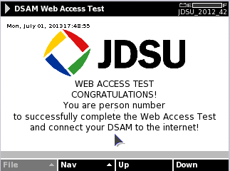
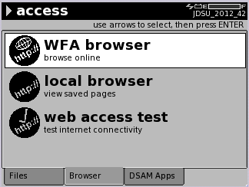
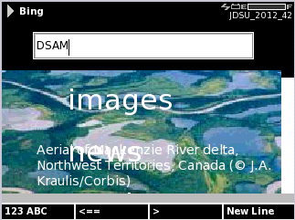
Validate Web Access via WiFi
DSAM can connect to external websites or to JDSU’s Web Access page to validate that the WiFi network is connected to the internet
  Requires WiFi Profile to be configured if the network is password protected
  WFA browser requires the Browser Option to be installed

Slide 8
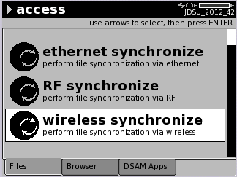
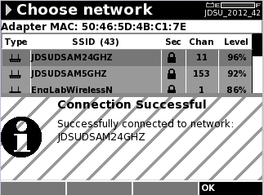
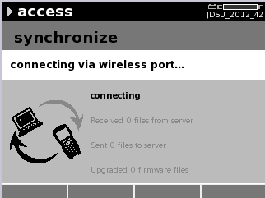
Synchronization to TPP or StrataSync (SS)
DSAM’s WiFi can be used to transfer files between TPP/SS to and the connected DSAM
  DSAM’s can be configured to sync over WiFi networks
  WiFi Profiles can be created on the DSAM and saved or can be created in TPP and pushed to the DSAM
  Multiple profiles can be setup and stored on the DSAM

Slide 9
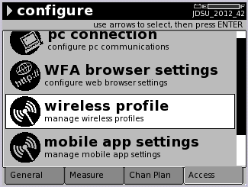
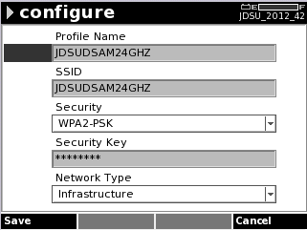
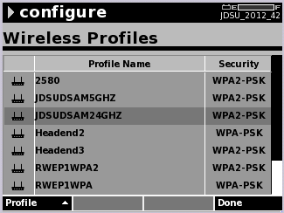
Configure WiFi Profile
Configuring Wireless Profiles
To add a new profile in the DSAM
  Configure Button
  Access Tab
  Wireless Profile
    Profile softkey
    New
Enter the WiFi Network’s information
  Profile Name, SSID, Security type
  Security Key and Network type
  Save
Entered profile now available in the Wireless Profiles list

Slide 10
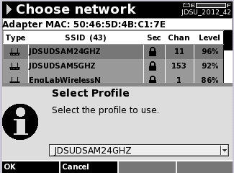
Wirelessly synchronizing to TPP or SS with DSAM
To sync DSAM to TPP or SS go to:
  Access Button
  Files Tab
  Wireless Synchronize
A list of available networks appears
  If a profile already exists for the network it will appear in the drop down list
  If a profile does not already exist one can be added by selecting “Create a new profile”
A pop-up appears when a successful connection is established
Wireless synchronization will now begin and the DSAM will return to the Access screen when complete

Slide 11
Notable Topics:
Enterprise WiFi networks do not work on DSAM
  Enterprise WiFi networks require an individual user name and password beyond joining/selecting the WiFi network
  A work around is to use a common retail Wireless Access Point or Wireless Router that is connected to an Ethernet port of the network which can access TPP/StrataSync server
    NOTE: Do not circumvent current IT procedures if present
DSAM works with the following list of approved USB adapters
Chipset | Known Adapters | DSAM firmware version | Notes
RT2571W | ASUS WL-167g (V1) | DSAM v4.0+ | V1 discontinued, V2 uses a different/incompatible chipset.
RT3572 | Asus USB-N53 | DSAM v4.2+ | This will be the JDSU replacement for the AE1000.
RT3572 | EnGenius EUB9801 | DSAM v4.2+
RT3572 | Engenius EUB600 | DSAM v4.2+
RT3572 | Linksys AE1000 | DSAM v4.0+ | Discontinued – This is JDSU’s currently shipping adapter until inventory runs out
RT3572 | Linksys WUSB600N (V2) | DSAM v4.0+ | Discontinued – other versions are known to be incompatible.
Notes:
Virtual DSAM can not be operated over the Wireless connection

