Slide 1
TAC Tips DSAM
#1 Setting the QAM sensitivity

Slide 2
Why set the sensitivity?
DOCSIS Chipset corrects for impairments in the QAM signal.
This does allows the for error free signal in a CATV system.
Problem: when signal signal is close to failure the it becomes difficult to find where impairment are occuring.
Solution: Set the DSAM QAM sensitivity from normal to High.
This setting removes some of the correction factors which allows the meter to see the impairments in the QAM signals.

Slide 3
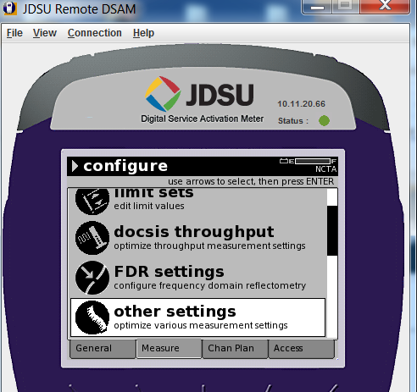
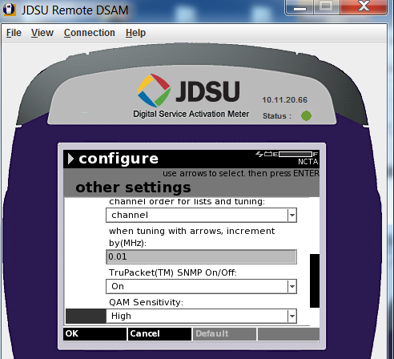
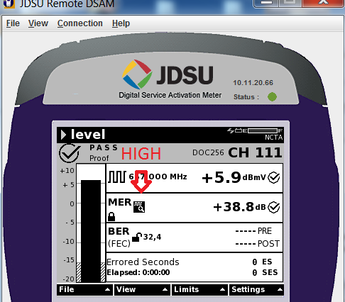
Setting the QAM sensitivity
Other settings
QAM sensitivity to High
The arrow is point the indication the meter has a high sensitivity setting enable

