Slide 1
OneExpert CATV – How to Fix Calibration Verification Failures and StrataSync Errors
There are two unit errors that can be fixed by upgrading to Firmware v2.9.5 or greater. If this process does not resolve the error the unit may need to be returned for repair.
Calibration Error
  Popup message “Calibration verification failed.” after powering on unit
Stratasync Error
  Popup message "Couldn't open save /cust/stratasync/listingReport.json“ or "Couldn't open save /cust/stratasync/optionReport.json“ after powering on unit
  Unit will not successfully connect to Stratasync
Correction Procedure
Upgrade to Firmware v2.9.5 or greater – Upgrade instructions are included in the following slides
  Calibration Error – upgrade by connecting unit to Stratasync and following the prompts (Refer to Slide 2)
  Stratasync Error – This error will prevent the unit from connecting to Stratasync and will require an upgrade using a USB device. (Refer to Slides 3-5)
After upgrade is complete, power on unit
  Calibration Error – A popup message will likely appear indicating the calibration is updating. Dismiss the message and wait for an additional popup to appear indicating the calibration update is complete.
  Stratasync Error – The original error message may appear. This is ok. Dismiss the error message.
Power the unit off and then back on to complete the process
  Note: This is the 2nd power on after the firmware update. It is required to power the unit on twice before the error will be corrected.

Slide 2
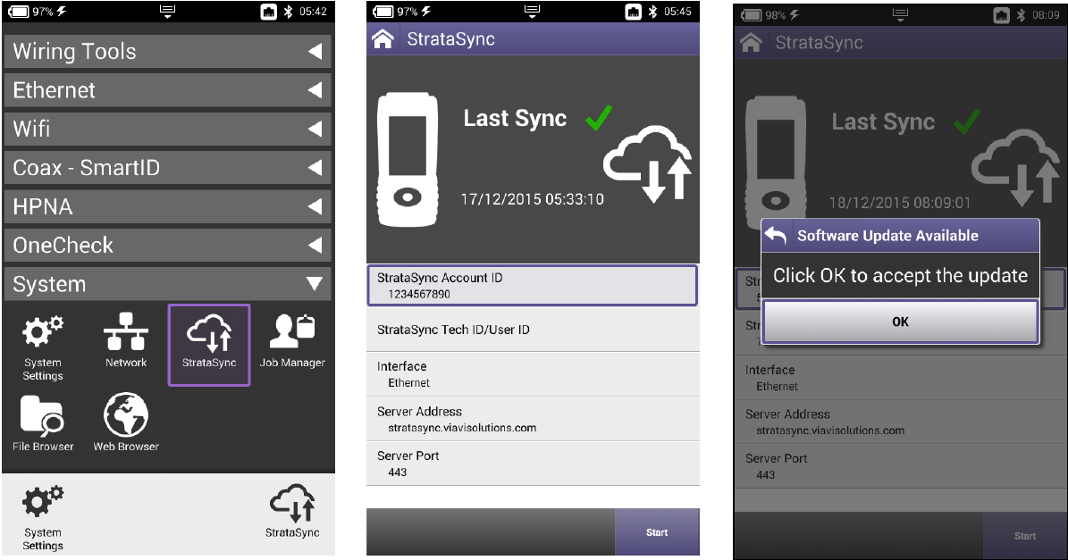
OneExpert CATV – Upgrade Through StrataSync
Go to System -> Network and verify network is up
Go to System -> StrataSync
Verify StrataSync Account ID is loaded
Press “Start”
If a firmware upgrade is available, an appropriate message will appear. Click “OK” to accept the upgrade.
Allow upgrade process to complete. Unit will transition to an upgrade screen, then power off automatically after upgrade is complete.

Slide 3
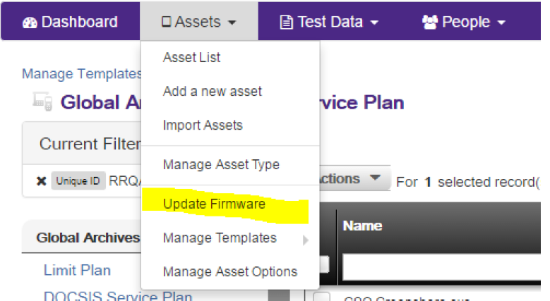
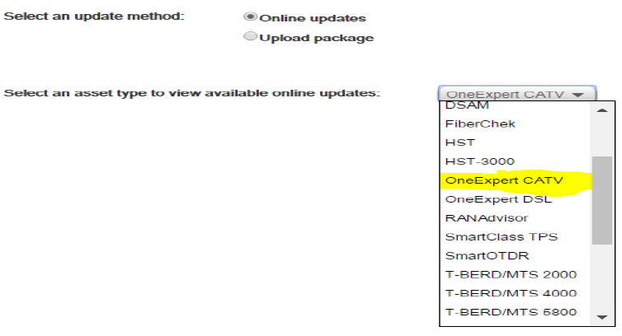
OneExpert CATV – Upgrade Using USB
Obtain the firmware package from StrataSync
  Log into StrataSync (make sure you have permission to upgrade units)
  Go to Assets -> Update Firmware
  Select “Online Updates”
  Select “OneExpert CATV” and click “Next

Slide 4
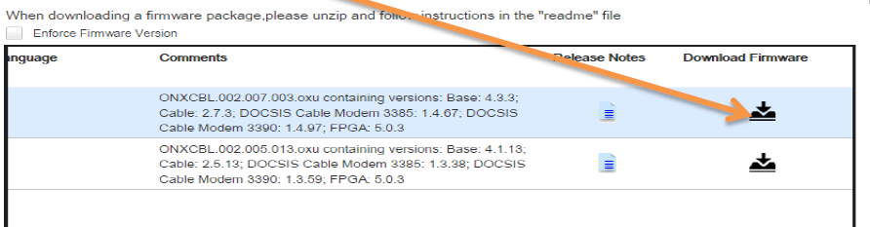
OneExpert CATV – Upgrade Using USB
Obtain the firmware package from StrataSync (continued from previous page)
  In the Update Firmware window, scroll to the right and click the Download Firmware link. The file will begin to download
  Once file has been downloaded, plug in the USB device and copy the firmware file to the device. The file name will be of similar format to “ONXCBL.xxx.xxx.xxx.oxu”
  Continued on next page

Slide 5
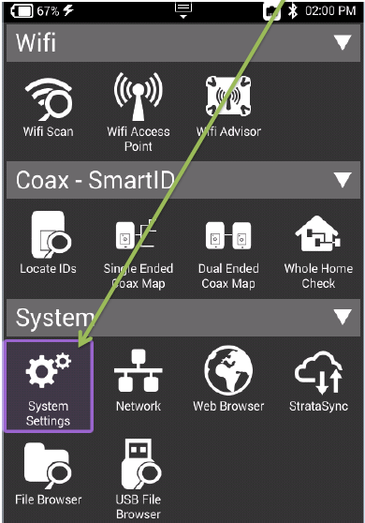
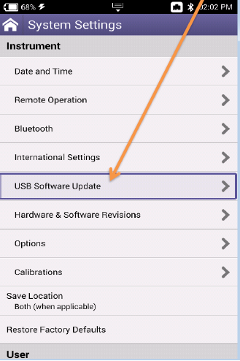
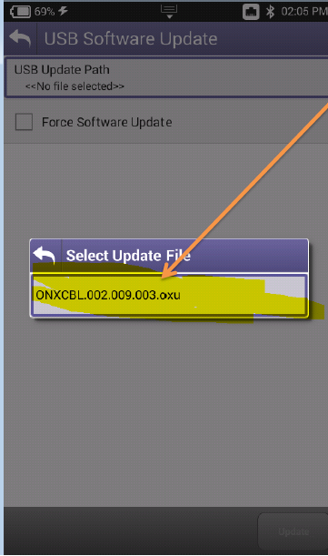
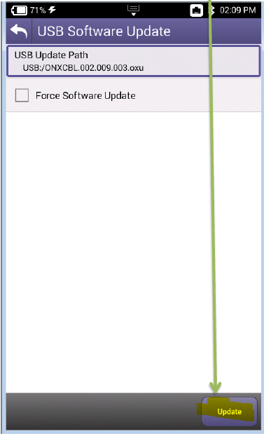
OneExpert CATV – Upgrade Using USB
2. Perform USB Software Update on Unit
  Power on unit and plug in the USB device to either of the USB ports located on the side of the unit
  Go to System -> System Settings -> USB Software Update
  Go to System -> System Settings -> USB Software Update
  Allow update to complete. Unit will transition to the upgrade screen, then power off automatically once upgrade is complete.

